Slide 1




Slide 2
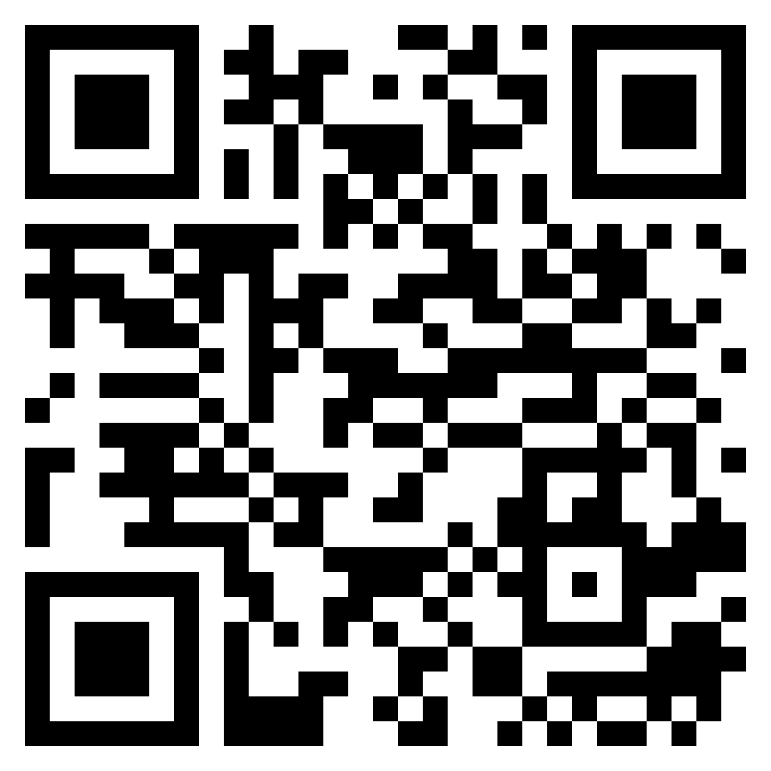
INTRODUCTION TO ALGORITHMS
URL: https://forms.gle/LsD6CnjK5gaVNHg98
QR CODE:

Slide 3

TIME AND SPACE COMPLEXITY

Slide 4
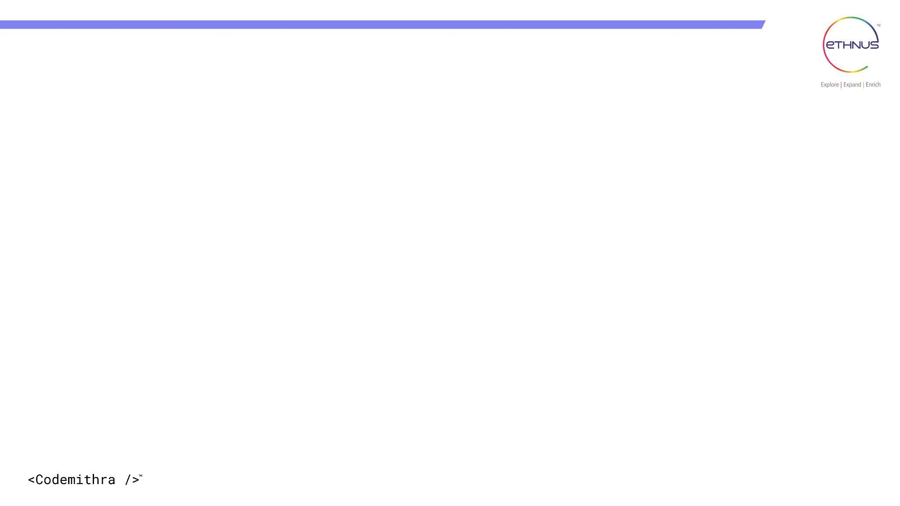

TOPICS
What is an algorithm complexity?
Time complexity
Space complexity
Analysis of algorithm
Asymptotic notation
1.Big oh (O)notation
2.Big omega (Ω) notation
3.Theta(Θ) notation

Slide 5
What is an Algorithm Complexity?
The complexity of an algorithm in Java, or any programming language, refers to the evaluation of its efficiency in terms of time and space requirements as a function of the input size. As mentioned earlier, algorithm complexity is typically categorized into two types:

Slide 6
a. Time Complexity: It measures the amount of time an algorithm takes to run as a function of the input size 'n'. Time complexity is denoted using Big O notation, which provides an upper bound on the growth rate of the algorithm's running time. The notation is expressed as O(f(n)), where 'f(n)' represents a function describing the worst-case time required for an algorithm.

Slide 7
b. Space Complexity: It measures the amount of memory space an algorithm uses as a function of the input size 'n'. Space complexity is also denoted using Big O notation, and it represents the upper bound on the additional memory space required by the algorithm during execution.

Slide 8
Analysis of Algorithm
The goal of analysis of an algorithm is to compare algorithm in running time and also Memory management.
Running time of an algorithm depends on how long it takes a computer to run the lines of code of the algorithm.
Running time of an algorithm depends on
1.Speed of computer
2.Programming language
3.Compiler and translator
Examples: binary search, linear search

Slide 9
Asymptotic Notation:
Expressing the complexity in terms of its relationship to know function. This type of analysis is called asymptotic analysis.
The main idea of Asymptotic analysis is to have a measure of the efficiency of an algorithm, that doesn’t depends on
1.Machine constants.
2.Doesn’t require an algorithm to be implemented.
3.Time taken by the program to be prepared.

Slide 10
Asymptotic Notation:
The mathematical way of representing the Time complexity.
The notation we use to describe the asymptotic running time of an algorithm is defined in terms of functions whose domains are the set of natural numbers.
Definition: It is the way to describe the behavior of functions in the limit or without bounds.
Asymptotic growth: The rate at which the function grows…
“growth rate” is the complexity of the function or the amount of resources it takes up to compute.
Growth rate Time +memory

Slide 11
Classification of growth
1.Growing with the same rate.
2.Growing with the slower rate.
3.Growing with the faster rate.

Slide 12
types:
They are 3 asymptotic notations are mostly used to represent the time complexity of the algorithm.
1.Big oh (O)notation
2.Big omega (Ω) notation
3.Theta(Θ) notation

Slide 13
Big-O- notation
Big-O notation represents the upper bound of the running time of an algorithm. Thus, it gives the worst-case complexity of an algorithm.

Slide 14
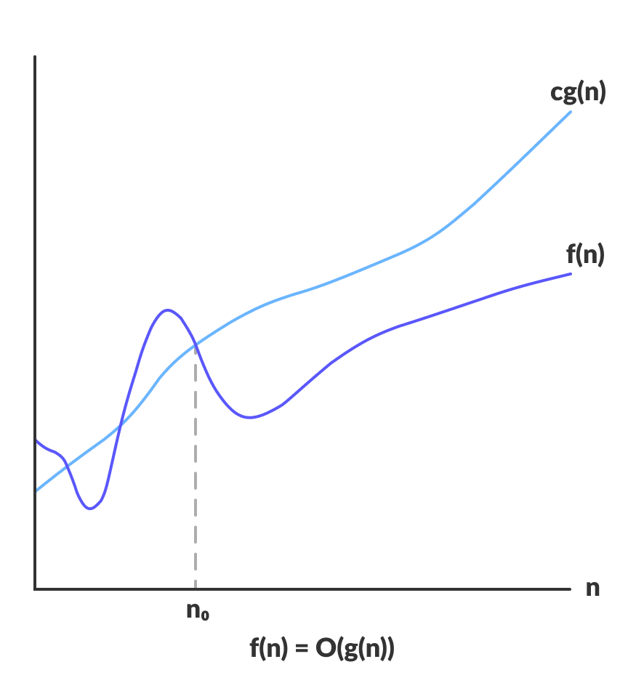
Big-O- notation

Slide 15
Big-O- notation
O(g(n)) = { f(n): there exist positive constants c and n0
such that 0 ≤ f(n) ≤ cg(n) for all n ≥ n0 }
The above expression can be described as a function f(n) belongs to the set O(g(n)) if there exists a positive constant c such that it lies between 0 and cg(n), for sufficiently large n.
For any value of n, the running time of an algorithm does not cross the time provided by O(g(n)).

Slide 16
Big-O- notation
Since it gives the worst-case running time of an algorithm, it is widely used to analyze an algorithm as we are always interested in the worst-case scenario.

Slide 17
Omega (Ω) notation
Omega notation represents the lower bound of the running time of an algorithm. Thus, it provides the best case complexity of an algorithm.

Slide 18
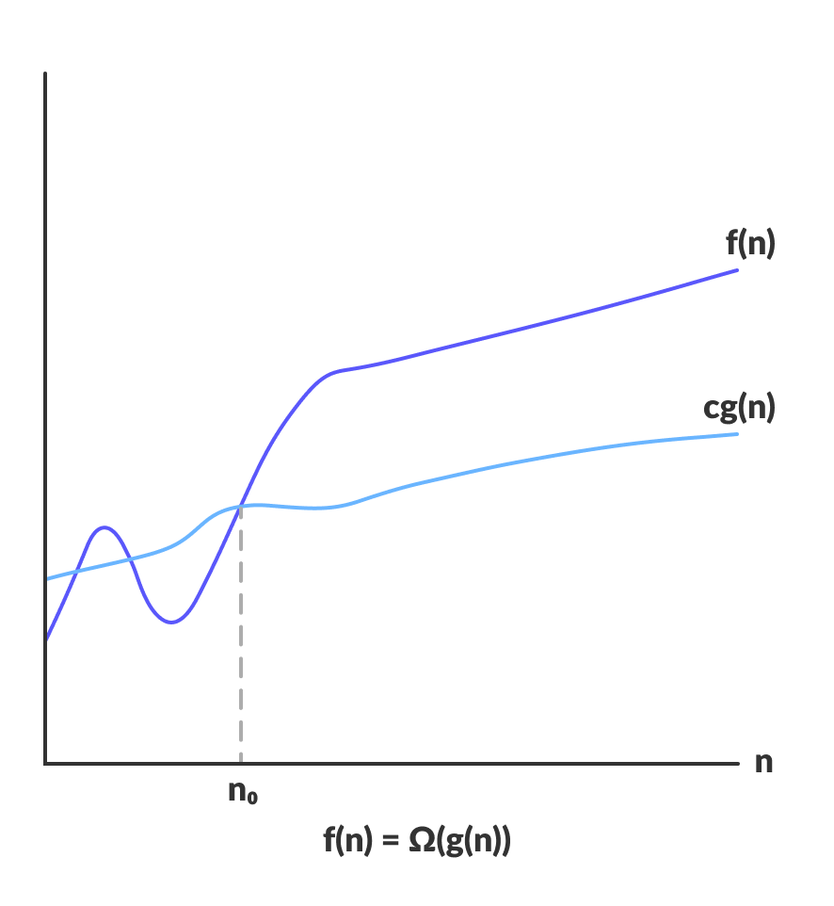
Omega (Ω) notation

Slide 19
Omega (Ω) notation
Ω(g(n)) = { f(n): there exist positive constants c and n0
such that 0 ≤ cg(n) ≤ f(n) for all n ≥ n0 }
The above expression can be described as a function f(n) belongs to the set Ω(g(n)) if there exists a positive constant c such that it lies above cg(n), for sufficiently large n.
For any value of n, the minimum time required by the algorithm is given by Omega Ω(g(n)).

Slide 20
Theta Notation (Θ-notation)
Theta notation encloses the function from above and below. Since it represents the upper and the lower bound of the running time of an algorithm, it is used for analyzing the average-case complexity of an algorithm.

Slide 21
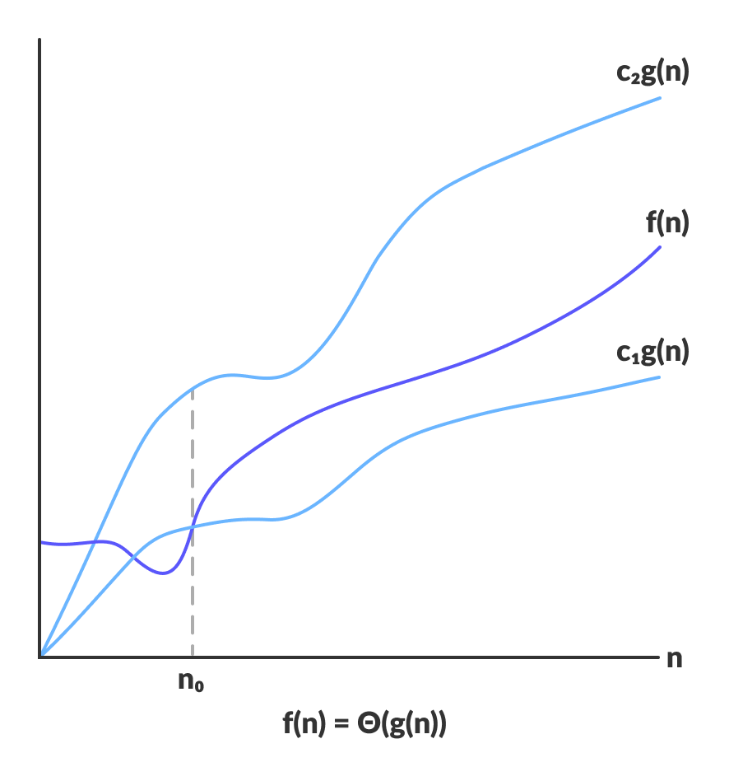
Theta Notation (Θ-notation)

Slide 22
Theta Notation (Θ-notation)
For a function g(n), Θ(g(n)) is given by the relation:
Θ(g(n)) = { f(n): there exist positive constants c1, c2 and n0
such that 0 ≤ c1g(n) ≤ f(n) ≤ c2g(n) for all n ≥ n0 }
The above expression can be described as a function f(n) belongs to the set Θ(g(n)) if there exist positive constants c1 and c2 such that it can be sandwiched between c1g(n) and c2g(n), for sufficiently large n.

Slide 23
Theta Notation (Θ-notation)
If a function f(n) lies anywhere in between c1g(n) and c2g(n) for all n ≥ n0, then f(n) is said to be asymptotically tight bound.

Slide 24
INTERVIEW QUESTIONS

Slide 25
Interview questions
1. What is the time complexity of the following code snippet?
void printPairs(int[] arr) {
for (int i = 0; i < arr.length; i++) {
for (int j = i + 1; j < arr.length; j++) {
System.out.println(arr[i] + ", " + arr[j]);
}}}
Answer: The time complexity of this code is O(n^2) since it uses nested loops to print all possible pairs of elements in the array.

Slide 26
Interview questions
2. How can you improve the time complexity of the previous code ?
Answer: You can improve the time complexity to O(n) by using a different approach. Instead of nested loops, you can use a single loop and a HashSet to keep track of visited elements.

Slide 27
Interview questions
3. Explain the difference between the time complexities of linear search and binary search algorithms.
Answer: Linear search has a time complexity of O(n) since it checks each element in the list one by one until the target element is found or the end of the list is reached. Binary search, on the other hand, has a time complexity of O(log n) as it halves the search space at each step, making it much more efficient for sorted arrays.

Slide 28
Interview questions
4. What is the space complexity of the following recursive function to calculate the factorial of a number?
int factorial(int n) {
if (n == 0) {
return 1;
} else {
return n * factorial(n - 1);
}}
Answer: The space complexity of this function is O(n) due to the recursive calls that are pushed onto the call stack until the base case is reached.

Slide 29
Interview questions
5. What is the significance of Big-O notation in algorithm analysis?
Answer: Big-O notation represents the upper bound of an algorithm's running time and gives the worst-case complexity. It helps us understand how the algorithm's performance scales with larger input sizes.

Slide 30
Interview questions
6. Explain Omega notation and its role in algorithm analysis.
Answer: Omega notation represents the lower bound of an algorithm's running time and provides the best-case complexity. It gives us the minimum time required by the algorithm for any input size.

Slide 31
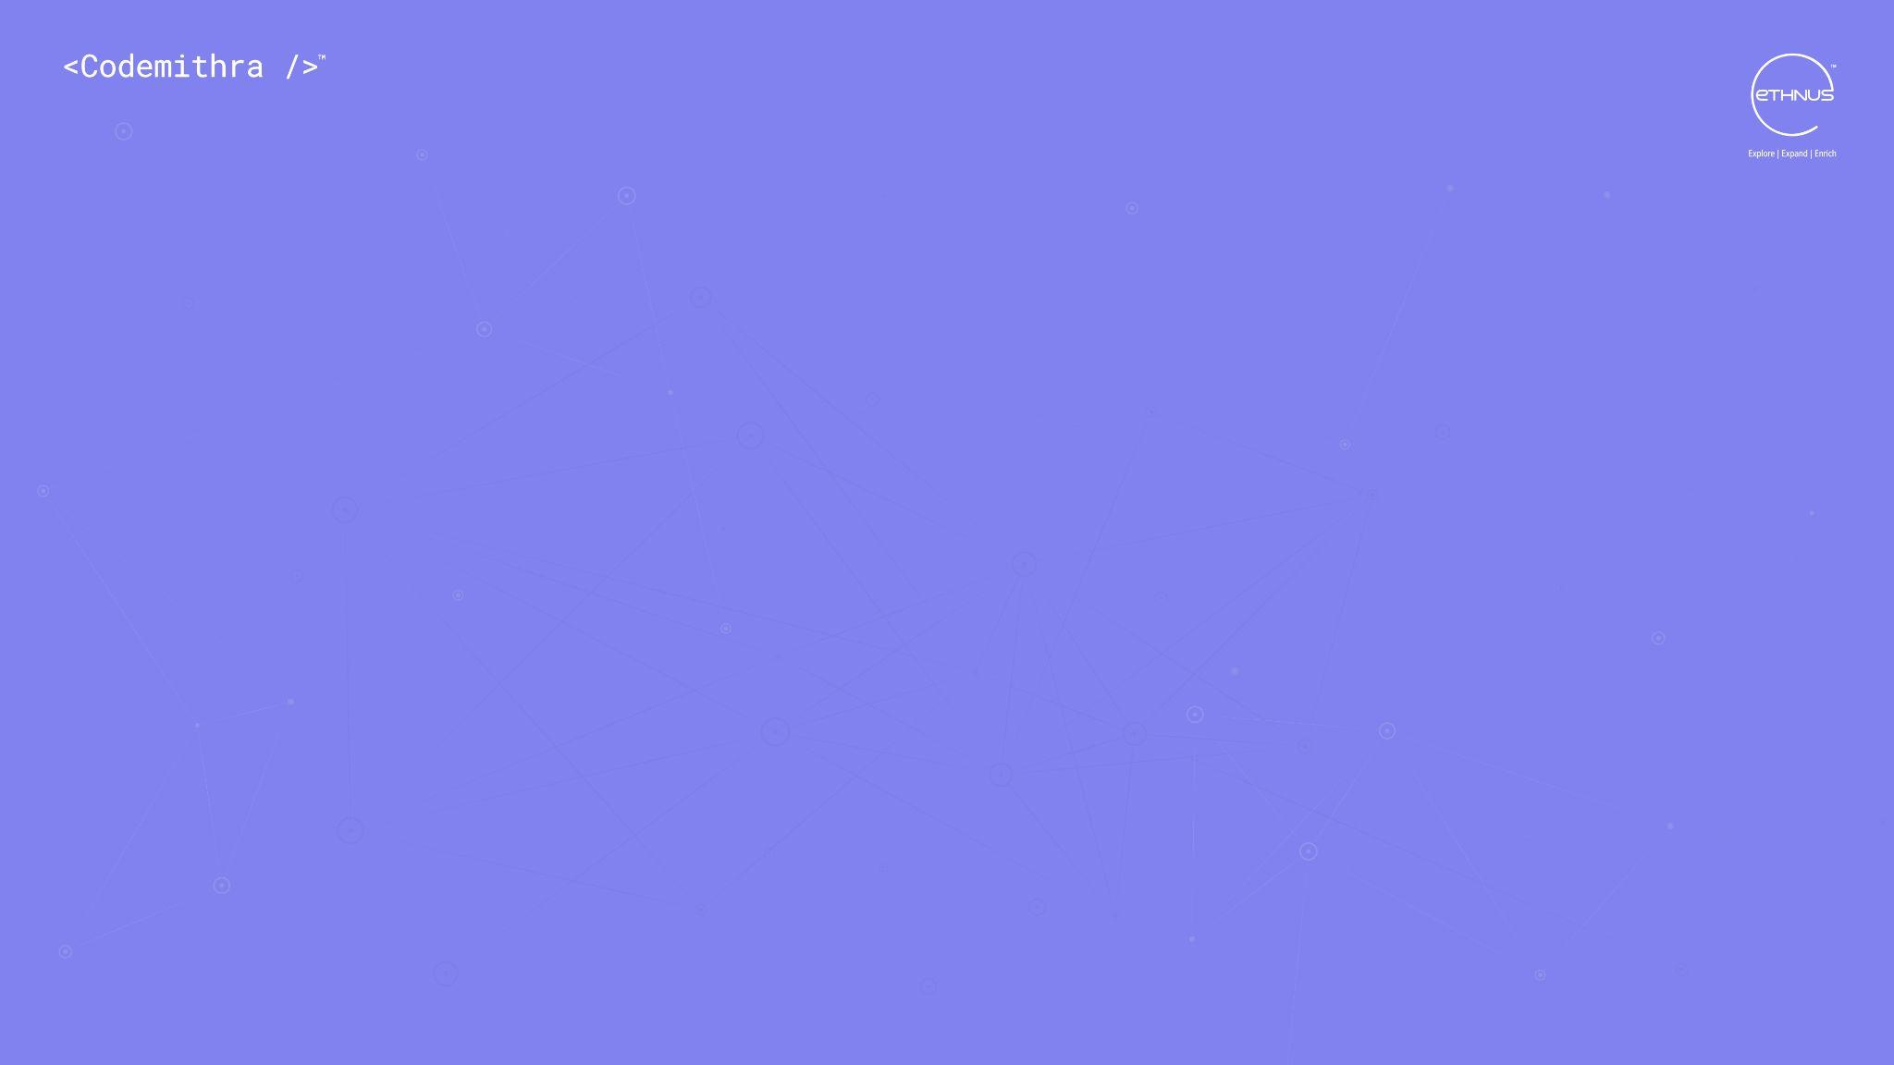



THANK YOU
+91 78150 95095
codemithra@ethnus.com
www.codemithra.com

